Slide 1

Inclusive Placement Opportunities for Preschoolers:
A Systems Approach to Preschool Inclusive Practices
A project of the Virginia Department of Education and the Technical Assistance Centers of Virginia
Notes:
Note to presenter: This module can be changed to reflect the needs of your audience; save the presentation to a location on your computer and make necessary changes.
This module contains activities to promote participant involvement aimed at improving retention of information presented. To learn more about participant-centered training strategies please refer to: Pike, R. (2002). Creative teaching techniques handbook: Tips, tactics, and how-tos for delivering effective training (3rd ed.). Amherst, MA: HRD Press. Or visit the Web site at www.bobpikegroup.com
Plan on at least 3 hours to present this module to a group if you use all of the activities and content. If you have a shorter time period, then you will need to adapt the Ppt.

Slide 2
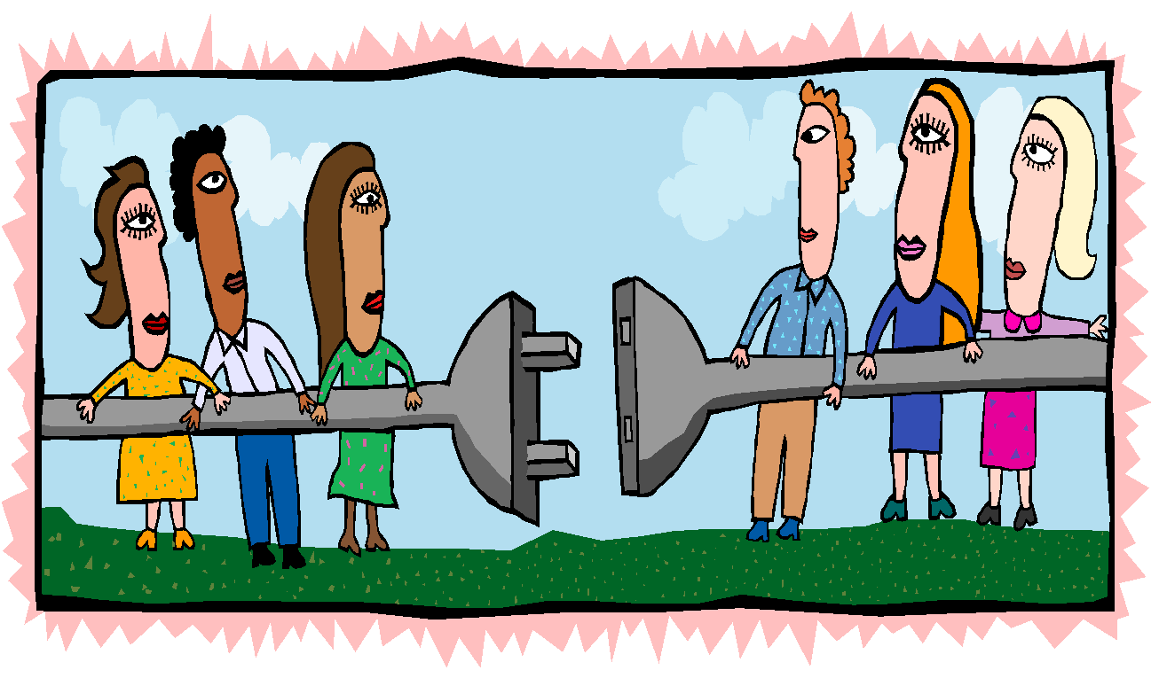
Module 2:
Collaborative Teaming
Notes:
Remember that some of the actions related to implementing your inclusion options are to become a collaborative team, practice skills, and use a structured meeting process. We are going to look at what this means and what it will look like in your programs.
Activity: Turn to your neighbor and share what you think a collaborative team means.
Give participants 3 to 4 minutes to discuss and then present the definition on next slide.

Slide 3
What is a collaborative team?
A group of diverse members who work together to
  share expertise
  address issues
  solve problems
Support the group’s mission and goals
Notes:
Ask if anyone had a similar response.

Slide 4
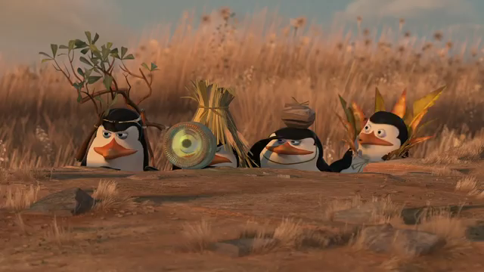
The Power of A Team (Video 1)
Retrieved from https://www.youtube.com/watch?v=DI4zp7yeuMU
Notes:
https://www.youtube.com/watch?v=DI4zp7yeuMU

Slide 5
What makes a team effective?
Shared beliefs and goals
Diverse membership
Shared leadership
Consensus decision making
Use of collaborative skills
Rules for sensitive issues
Notes:
Effective teaming requires that you have some basic components. These include the items on the slide.
What makes an effective team member? The way we communicate is very important when we are working with others.

Slide 6
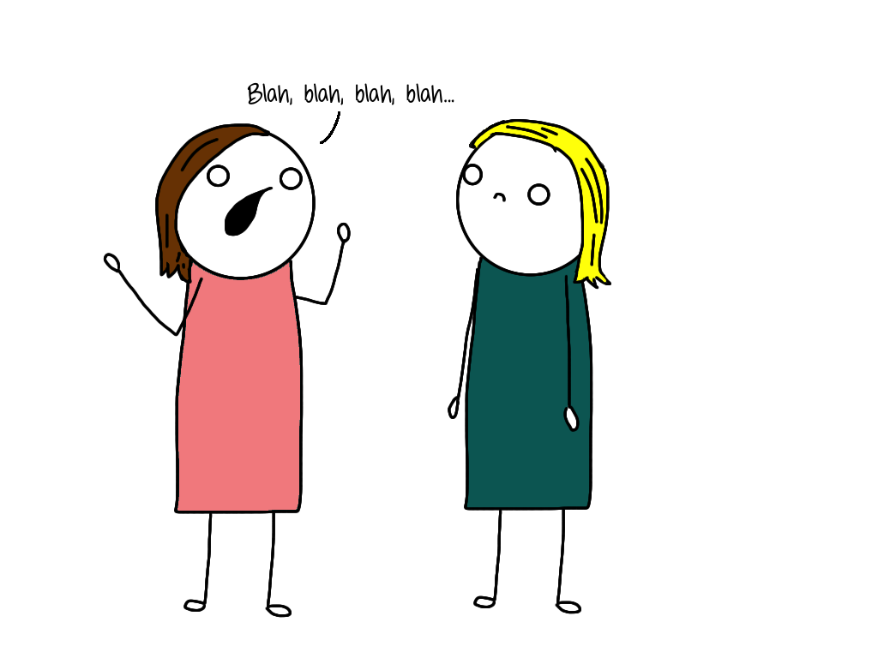
What is your personal communication style?
Notes:
Activity: Let’s see what your communication style (teaming type) is, as well as your teammates’ styles.
Handout: Distribute the Understand your personal style and the styles of those around you handout to participants.

Slide 7
To Complete the Survey. . .
Go from left to right
Put a check or a 1 by the word that is most characteristic of you
Total Column B on page one
Repeat process on page two and total Column C
Plot total of Column B on the vertical axis
Plot total of Column C on the horizontal axis
Notes:
Explain how to complete the survey, using the directions on the slide.
Presenter will put the drawing of the graph on flip chart paper.
Instruct the participants to connect the dots once they have plotted their numbers on the graph.
Whichever quadrant they fall in is their primary communication style.

Slide 8
Four Types of Team Members, Slide 1
Thinkers: Careful, precise, formal, private, reserved, logical, inventive, and reflective
Directors: Take charge, control-oriented, competitive, motivated to be number one, task focused, achievers, and strong-willed
Notes:
Share characteristics of each type with participants.

Slide 9
Four Types of Team Members, Slide 2
Socializers: Optimistic, fast paced, emotional, approval seeking, enthusiastic, impulsive, and expressive
Relaters: Easy going, slow paced, diplomatic, predictable, persistent, modest, accommodating, and friendly
Notes:
Share characteristics of each type with participants.

Slide 10
Four Ways People Operate
Task oriented (thinkers and directors)
People oriented (relaters and socializers)
Fast paced (directors and socializers)
Slow paced (thinkers and relaters)
Notes:
Ask: Have you worked with team members who were more task or people oriented?
What does each type bring to the team meeting?
How might pacing impact a team meeting?

Slide 11
Supporting Different Teaming Types
Thinkers: Provide explanation and rationale; give processing time
Directors: Agree on goals and boundaries; allow to do their “thing”
Socializers: Support feelings and focus on the big picture
Relaters: Use reasoning and data; present ideas that minimize risk
Notes:
Ask: What can your team do to support the different styles of the team members?
Take 5 – 10 minutes to discuss and jot down some ideas that will support your styles.

Slide 12
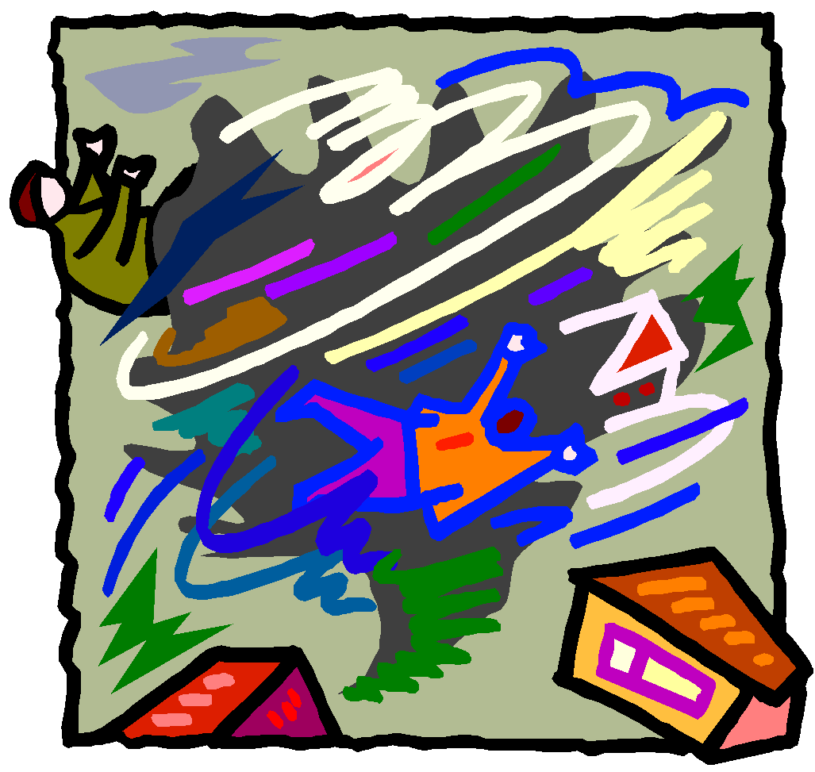
Stages of Team Development
Forming
Storming
Norming
Performing
Notes:
After thinking about personal communication styles, let’s turn our attention to how the group comes together as a whole.
According to research, there are four stages to teaming: forming, storming, norming, and performing. All teams go through these stages and may revert back to stages at various points.
Discuss with your team members what you believe each of these stages may look like as you begin a new initiative. What do you believe could occur to cause the team to revert back to a prior stage? (Think about your prior experiences)

Slide 13

Forming Stage
Develop a sense of purpose and identity
Trust level low
Communication guarded
Notes:
The forming stage is when the team is just beginning to work together.
Communication is generally guarded as individuals get to know each other and talk about their task.
Everyone is on good behavior. This is the initial relationship stage that we all experience in new and exciting relationships.

Slide 14
Storming Stage
Search for group values, procedures, and norms
Possible competition for group control and leadership
Erratic interactions
Communication may be angry, distorted, or confrontational
Notes:
In the storming stage, teams have formed and they are communicating more.
The team is beginning to divide up roles and members might be competing for control or a voice.
Different styles of approaching tasks will emerge and conflict is present.

Slide 15
Norming Stage
Develop a shared sense of values, expectations, procedures, and traditions
Openness in communication
Issues shared more easily
Notes:
In the norming stage, the team has worked out a plan and a way to work together. They have agreed on roles and procedures and come to respect the diversity that each member brings.
Share some roles and procedures that may actually be in place in a teaming situation.
Ask: Do all members of the teaching team participate in the set up of the classroom environment? Delve into participants thinking so they understand everyone may participate to a quality classroom, but only two people may do the set up, not all of the members of the teaching team.
Ask: How are shared responsibilities different from same responsibilities? Give some examples.

Slide 16
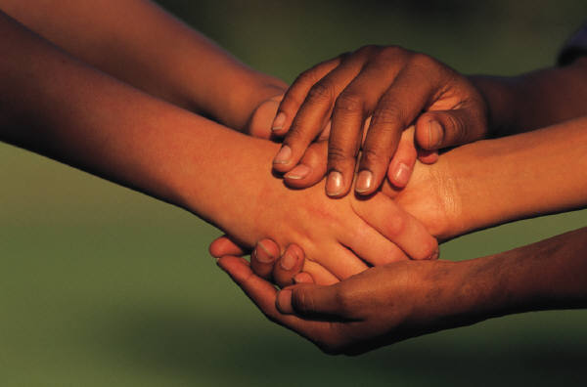
Performing Stage
Strong sense of “we” and team cohesiveness
Efficient in making decisions and resolving conflict
Interaction patterns are group-centered
Notes:
During the performing stage the team is really rolling along. They have a very fine-tuned system of communication, dividing up tasks, and distributing responsibility and authority, as well as a process for handling conflict.
Teams may also revert to former stages at times. For example, if a team is at the performing stage and a new member is added, they will return to the forming, storming, and norming stages. Likewise if the team takes on a different task, they may revert to the previous stages.
Activity: Take a minute to reflect on your team and determine your team’s current stage.

Slide 17
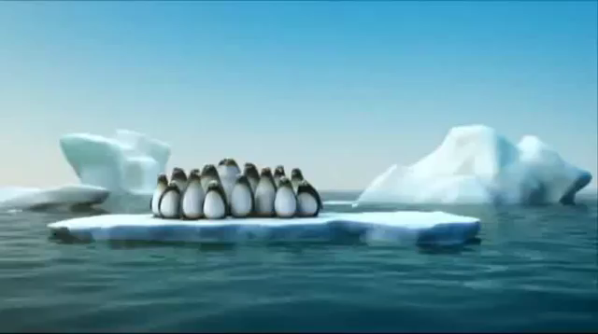
The Power of A Team (Video 2)
Retrieved from https://www.youtube.com/watch?v=wuo13FrNX6g
Notes:
https://www.youtube.com/watch?v=wuo13FrNX6g
Ask: At what stage are these teams?

Slide 18
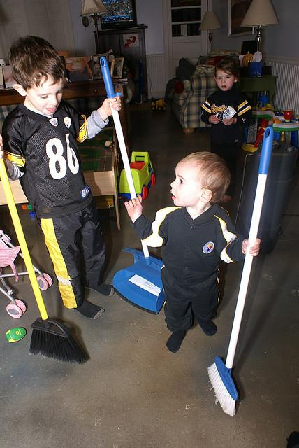
Skills Necessary for Collaborative Teaming
Exchanging information
Communicating effectively
Process for solving problems
Resolving conflicts
Notes:
Some skills are necessary when teaming. You must create an exchange of information, communicate effectively, have a process for solving problems, and a way to handle conflict. Let’s take a look at each of these skills.
Exchanging information
Role release
Teaching each other
Communicating effectively
Beware of perceptions
Active listening
Process for solving problems
Brainstorming solutions
Reaching consensus
Resolving conflicts

Slide 19
Exchanging Information Through Role Release
Team members must see each other as equals
Must be willing to listen to others’ ideas regardless of their position
Must be willing to rotate leadership within the team
Notes:
In order to exchange information, you must release your role and listen to others’ ideas and be willing to rotate leadership within the team. The team meeting process which will be addressed later will assist in rotating leadership if the team commits to the rotation of responsibilities.
To create a free exchange of information, you must be able to teach each other and release your roles. You have diverse members on your team for a reason, but if you are a collaborative team and you are making joint decisions, you must not have an administrator that makes all the decisions.

Slide 20
Exchanging Information By Teaching One Another
A volunteer will give directions to the group regarding how to draw a picture, without using eye contact or hand motions
The audience is not allowed to ask questions
Notes:
An effective exchange of information also relies on being able to teach each other.
Activity: Have participants draw the diagram that is being described by one participant (One Way Communication handout, next slide). Explain to the person giving the directions that they should just say the information once and can’t answer any questions asked.
After they have finished, show the diagram (have it on a flip chart) and ask “Who has something that looks like this?” Most will not have it.
Ask those who did not, “Why not?” Most will say they could not ask clarifying questions, just had to listen, etc.
Point out how clarifying and clearly stating things is necessary when teaching one another.

Slide 21
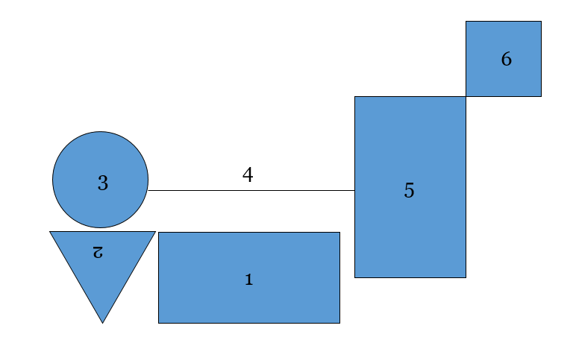
One-Way Communication
Notes:
Does your diagram look like this?
Discuss with your partner how the directions could have been provided to be clearer to the “drawer.”

Slide 22
Communicating Effectively: Active Listening
Pick one person at the table
Identify the sequence of people to share information
Each take a few minutes to share something your table partners would not know about you
Partners receiving information will listen without interrupting
Notes:
Communicating effectively is yet another skill that we must have to work with a collaborative team. Listening is a real skill. Why can listening be so hard?
For example:
You are thinking of how you are going to respond to the person talking while s/he is talking.
Your mind is wandering and you are thinking about dinner, etc.
You are so sure you are right that you don’t listen.
Activity: Take a moment to do this activity at your tables. After the activity, discuss: How can you be a more effective listener?
One strategy is to listen without interrupting and then report to the speaker what was heard and check for accuracy.

Slide 23

Communicating Effectively: Beware of Perceptions
Notes:
Ask: “What do you see?”
Some of you might have seen the vase or goblet right off, while others may have only seen the two elderly people or the two people wearing hats playing a guitar.
What you saw became your reality and your perception was that there could not be anything else in the photo. You realized this was not the case when others pointed out the things they saw in the photo.
That is why teaming can be so beneficial. We all see things through a different lens, with each lens adding more important information and contributing to a complete understanding of the image.

Slide 24
Process for Solving Problems
Clearly define the issue (if too large, break into smaller issues)
Generate solutions
Decide on a solution
Evaluate effectiveness
Revise the plan as needed
Notes:
You must have a process by which you can solve problems.
You will most likely have many problems as you implement this model.
Having a process of how you will find solutions will help.

Slide 25
Clearly Define the Issue
State concerns and issues as problems to be solved by asking:
  What …?
  How …?
  When …?
  Where …?
Notes:
One thing that helps is to state concerns, issues, or agenda items as a question. Stating the issue as a question serves two purposes:
1. It causes you to clearly define and narrow the focus of the concern.
2. It enables you to bring up issues in a non-threatening way. For example, in a collaborative ECSE and Head Start preschool classroom, the ECSE teacher never follows the lesson plans that have been developed by both teachers. Instead of coming to the meeting and saying, “You never do what we plan,” which may make her defensive, you could word the problem as a question (e.g., “How can we be sure to implement the lesson plan that we developed and agreed on?”). If possible, use coaching strategies (reflective questioning).

Slide 26
Generate Solutions
Brainstorming:
No critical judgment allowed
Free-wheeling is welcome
Go for quantity, not quality
Use a round robin strategy
Set a short time period
Record words or phrases only
Notes:
Another skill needed in collaborative teaming is brainstorming. I am sure you already use this skill but it is important to revisit some of the components of brainstorming.
Review the list on the slide.

Slide 27

Brainstorming Activity
Notes:
Activity: Let’s practice brainstorming. In the next 60 seconds, brainstorm ways to share information about IPOP.
In your teams:
Think of ways you will share the information about IPOP with your community, school, and program members
Follow the rules for brainstorming
Have someone record ideas
You have 60 seconds
GO!!

Slide 28

Consensus Decision Making
Striving to reach a decision that best reflects the thinking of all team members
Notes:
Another collaborative teaming skill is that of reaching a consensus as a team.
In consensus decision making you strive to reach a decision that best reflects the ideas of all members of the team.

Slide 29
Types of Decisions
Win-Lose
Lose-Lose
Win-Win = Consensus
Notes:
Consensus does not mean that everyone loves or even likes the decision that was decided on.
It does mean that everyone agrees they can live with the decision, will implement it and will not sabotage it.

Slide 30

Guidelines for Making Decisions by Consensus, Slide 1
Assume problems are solvable
Listen to each team member
Seek out differences of opinions
Involve everyone in the decision process
Notes:
Some guidelines for reaching a consensus are:
avoid win-lose situations,
present your position clearly and logically, and
listen to each team member’s reaction.
Share items from the slide.
If a team member is not contributing, specifically ask him/her, “What are your thoughts?”

Slide 31
Guidelines for Making Decisions by Consensus, Slide 2
Search for the most acceptable alternative when the team reaches a stalemate
Support only solutions which are acceptable to all
Ask, “Is there anyone who cannot live with the solution?”
Notes:
Some guidelines for reaching a consensus are [share items from the slide].

Slide 32
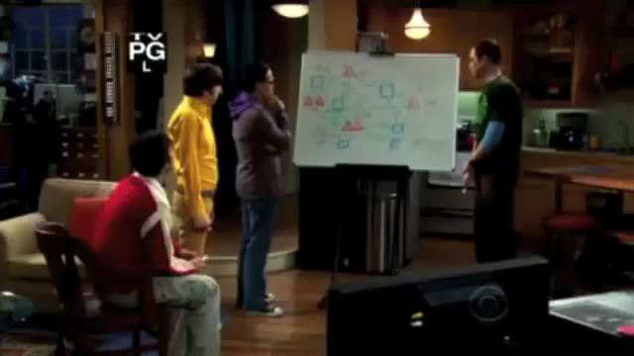
Big Bang Theory
Retrieved from https://www.youtube.com/watch?v=8Amu3UBj-qw
Notes:
https://www.youtube.com/watch?v=8Amu3UBj-qw
Is this consensus?

Slide 33

Consensus Activity
In teams:
Reach consensus on the strategies for sharing IPOP information with others
Notes:
Activity: Reach a consensus on the items you brainstormed earlier.

Slide 34

Resolving Conflict:
Reaching a higher level of understanding
Notes:
Conflict is going to occur when people are working together. You will experience it related to this initiative.
The best plan is to have a plan of how you will deal with conflict.

Slide 35
Conflict is...
The tension that exists when people or organizations have conflicting or competitive goals
A state of disagreement and disharmony
Notes:
Everyone has experienced conflict at some point.
Ask: “How would you describe conflict?” Have brief discussion.

Slide 36
Attitudes About Conflict
Is there good conflict?
Why do we avoid conflict?
How can we resolve conflict?
Notes:
It may benefit you to examine your feelings about conflict. Some may hate any type of conflict and therefore avoid it at all costs. Others may view conflict as positive, leading to a higher level of understanding.
Activity: Turn to the person sitting next to you and take a minute to discuss these questions about conflict. Then discuss the questions with your team. Discuss the ways conflict may occur related to your team beginning or expanding on inclusive opportunities, such as families, staff, etc.

Slide 37


How do you handle conflict?
Notes:
Let’s see how you handle conflict.
Communicating can be compared to a hard ball and an egg.
When we are working with people and having everyday communications with them, we talk easily, conversation flows. Since we are not having conflict we feel at ease communicating about things. We “toss” ideas back and forth with little concern about how we are saying them - just like you would toss a hard ball. You are not guarded about dropping it.
When you need to communicate more sensitive issues that may relate to conflict, you are more careful about how you word what is said. When tossing an egg to another person, you are careful because it might break. The same applies to communication.
Ask: “How do you currently handle conflict (i.e., walk away, avoid, take it on directly, etc.)?” Participants share.

Slide 38
When Conflict Occurs:
Face it and negotiate
  Allow adequate time to discuss
  Commit to resolve
  Communicate viewpoints; focus on behaviors not personality traits
  Use personal statements, such as “I,” “me,” or “mine”
  Listen to other people’s points of view
  Be open to new perspectives
  Reach an agreement on the definition of the problem
  Request and negotiate change
Work together
Notes:
One thing that helps is talking about conflict and what you will do before it occurs.
Think about the skills on the slide.

Slide 39

Example of a Conflict Resolution Policy
Notes:
Here is an example of one team’s process for handling conflict when it occurs.
The team member experiencing conflict must initiate the discussion.
The person in conflict must contact the other person directly.
The person approached is obligated to discuss, even if he or she does not have a conflict.
If approached by a colleague who reports a conflict with a third member, the first member must direct the colleague to discuss the conflict directly.

Slide 40
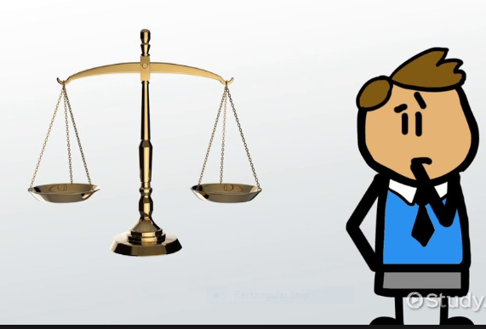
Conflict Resolution Policy (con’t.)
Notes:
If aware of a conflict between two or more members, the member must express concern to those involved and encourage them to follow policy and resolve conflict.
If two or more members meet to resolve conflict and cannot, they can request a third person meet with them.
If ongoing conflict is not resolved, administrators set up meeting for win-win solution.
Can be brought to the whole team if members agree.
Administrators decide how to best resolve issues.

Slide 41
Using a Structured Meeting Process
Process that enables all members to have a role
Process that allows teams to be efficient
Process that holds team members accountable
Notes:
We mentioned that we are going to share a structured team meeting process with you.
There are many such processes and you may already be using one.
The important thing is to have some process by which you can be more efficient and effective by assigning roles and holding team members accountable.

Slide 42
What bothers you most about meetings?
Turn to your neighbor and share what bothers you the most about meetings you have attended
Notes:
Activity: Turn to your neighbor and share what bothers you most about meetings.

Slide 43

What others say...
Too many meetings
Too much time in a meeting
Too many issues
Too many talkers
Too few talkers
Not making decisions
Rehashing decisions
Not remembering what was decided
Ignoring interpersonal conflict
Notes:
Ask: “Were any of these issues mentioned?”

Slide 44
If You Don’t Like Meetings, The Bad News Is...
Meetings related to the inclusion of students with disabilities and making systems change are very necessary for the success of the collaborative efforts.
Notes:
We may hate meetings but they are necessary. These meetings are sacrosanct!

Slide 45

The Good News Is...
They do not have to be unproductive and a waste of time!

Slide 46
How can we make meetings more efficient?
Attend
Participate
Initiate discussions
Communicate and share
Speak and listen
Problem solve
Make decisions
Notes:
Share how to make meetings efficient.

Slide 47
Team Meeting Process
Assign roles
Set time limits
Conduct the meeting
Notes:
We have a team meeting process that we would like to share with you. Please look at the yellow handout that is on your table. Using this format, complete the steps on the slide.
Handout: Distribute Team Meeting Notes to participants.
Celebrate
Review past meeting notes, carry over incomplete tasks as issues
List issues
Prioritize issues
Brainstorm solutions
Reach consensus on solutions
Record who will do what by when
Carry over issues not addressed

Slide 48
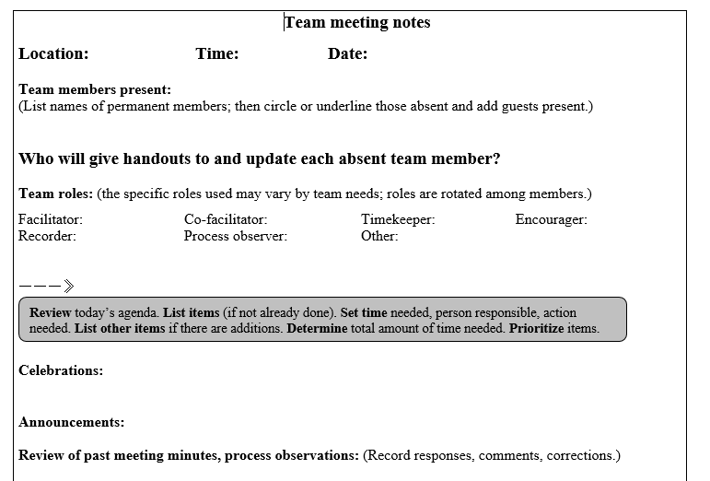
IPOP Meeting Agenda
Notes:
Sample of an IPOP agenda

Slide 49

Roles in Collaborative Teams
Facilitator
Agenda keeper
Time keeper
Recorder
Encourager
Observer
Notes:
Facilitator – keeps meeting going. Facilitates discussion related to agenda items.
Agenda keeper – keeps members on the agenda item being discussed. Reminds team members when they are off topic.
Timekeeper – keeps time for each agenda item during the meeting and reminds the team when time is up.
Recorder – uses the team meeting form to record all tasks, who is responsible for them, and deadlines.
Encourager – notices if certain members of the team are quiet or not sharing and gently urges them to voice their opinions.
Observer – watches the processes and interactions used during the meeting and provides feedback at the end so members are aware of how they are interacting and may make changes based on the feedback from the observer.

Slide 50
How To Begin
Assign roles
Assign times
Celebrate
Review past notes, carry incomplete tasks over as issues
Notes:
Begin the meeting by assigning roles. Some teams may decide on roles prior to the meeting, such as establishing a schedule for facilitators, recorders, and agenda keepers. Other teams decide at each meeting. Some have even developed a spinner with the roles on it to be assigned at the meeting. The important thing to remember is that rotating roles is necessary. You want to give everyone a chance to be the facilitator, recorder, etc.
Always assign times to each part of the meeting and agenda items. For instance, ask the team how long the meeting will last (ex., 1 hour). Each segment of the meeting should also be assigned a time limit, such as beginning the meeting with 1-2 minutes for personal or professional celebrations.
Assigning 2-3 minutes to review past notes allows team members to see if tasks from the previous meeting were completed, or if they need to be placed on the current agenda.

Slide 51
Team Meeting Process (con’t.)
List agenda items
Prioritize
Brainstorm solutions for each agenda item
Reach consensus
Record (who, what, when)
Notes:
List issues – 1-2 minutes. Note this time is strictly for listing agenda items, not for discussing and brainstorming them. Remember to list agenda items as questions.
Brainstorm solutions, reach consensus, and assign times to each agenda item. Use your brainstorming skills and reach consensus to come up with solutions to the agenda items.
Recorder – records the agenda item and only the task discussed, who will complete this, and the deadline.

Slide 52
Team Meeting Process (con’t.)
List issues for carry-over
List date, time, and location of next meeting
Assign member to distribute notes
Notes:
Carry-over – if time did not allow you to get to all agenda items, make sure you have recorded these for discussion at the next meeting.
Make sure you put the date, time, and location of the next meeting on the meeting notes.
Have someone take the role of copying the notes for all team members and distributing them. Make sure you get notes to the members who were not in attendance.

Slide 53
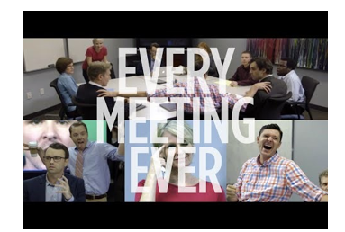
Stellar Team Meeting
Retrieved from https://www.youtube.com/watch?v=K7agjXFFQJU&t=7s
Notes:
Examples of a less than stellar team meeting.
https://www.youtube.com/watch?v=K7agjXFFQJU&t=7s

Slide 54
Let’s Reflect
What members need to be added to our team?
When and where will our monthly team meetings take place?
What information do we need to know as we plan for inclusion opportunities?
Do we want to visit other sites?
What will our team be called?
What data do we need to collect and who will collect it?
Do we want to meet with IPOP partners from across the state again? If so, how often and for what purpose?
What else?
Notes:
Activity: If you have time remaining (15 minutes), one could ask participants to form a team, assign roles for a meeting, and hold an initial meeting for the IPOP initiative.
Remember to include all members in determining agenda items.

Slide 55
Enjoy the process and... become a “performing” team!
Notes:
Close on a positive note.

Slide 56
References, Slide 1
Communication: Handling conflict. (1999). Adapted from The Leading Edge, Presentation at the National Association for the Education of Young Children Annual Conference.
Friend, M., & Cook, L. (2013). Interactions: Collaboration skills for school professionals. Upper Saddle River, NJ: Pearson.
Giangreco, M.F. (2000). Anatomy of effective team members. Minnetoka, MN: Peytral Publications.

Slide 57
References, Slide 2
Gupta, S., Henninger, IV, W.R., & Vinh, M.E. (2014). First steps to preschool inclusion: How to jumpstart your programwide plan. Baltimore, MD: Paul H Brookes.
Hayden, P., Frederick, L., & Smith, B.J. (2003). A road map for facilitating collaborative teams. Longmont, CO: Sopris West.
Understand Your Personal Style and the Styles of Those Around You. Retrieved 2/25/2015, from www.utoledo.edu.

Slide 58
Thank You!
If you have any questions about the content in this module or need further assistance implementing a systems approach to early childhood inclusive practices, please contact the early childhood staff at the following T/TACs.
Regions 1 & 8 VCU 804-828-6947 or 434-292-3723
Regions 2 & 3 ODU 757-683-4333
Region 4 GMU 703-993-4496
Region 5 JMU 540-568-6746
Regions 6 & 7 VT 540-231-5167

